Slide 1
Welcome to
Open House
Ms. Jenny
Kindergarten

Slide 2
Off to a great start!
Kindergarten can be a big adjustment to a 4 or 5 year old.
More responsibilities (increase in class work, less “playtime” than in Preschool, daily homework, taking tests)
New rules and procedures (classroom rules,
lunch in gym, dismissal in gym, PE or library
everyday, less nap time)
Kindergarten has changed so much
since we were in school. Please continue
to encourage your child!

Slide 3
Reading
Now through beginning of December we are learning two letters/sounds a week, blends, and one vowel words. Goal is to master reading one vowel words by December.
December through May we will learn long vowel sounds, special sounds, and begin reading two vowel words. Reading centers will
begin in January. (sample booklets)

Slide 4
Writing
Learning how to write is a process. We start by being able to sound out a word and write any sounds we hear. It is okay for a word to be misspelled in Kindergarten. Then next step is writing a sentence with all the components. (Capital letter, spaces, punctuation)
Circle Maps & Four Square Writing
Method (sample)
Goal: 5 sentence paragraph by 4th
nine weeks

Slide 5
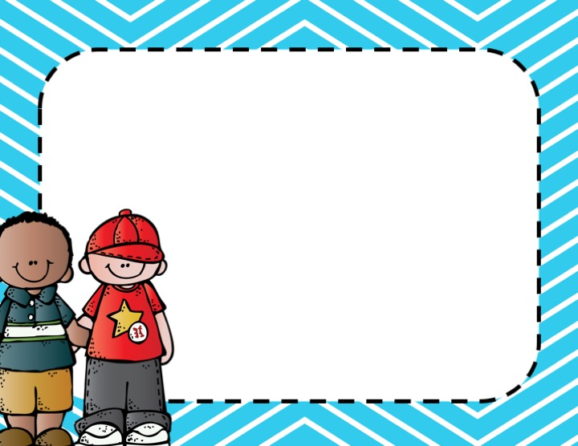
Contact Information:
Please feel free to contact me by Bloomz or email if you have any questions or concerns.
If you need to set up a conference we can always schedule one during my planning time, 1:00-1:45.
Website has lots of resources to help with school.

Slide 6
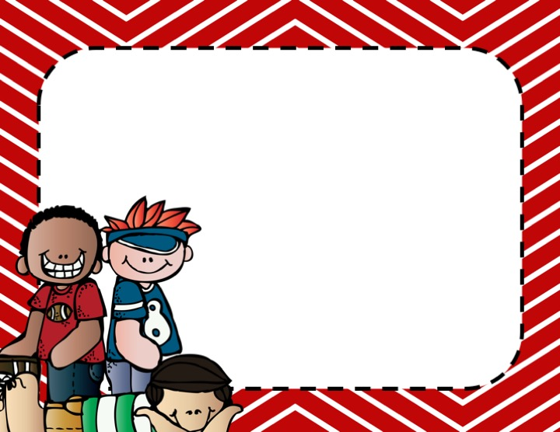
I am looking forward to a wonderful year. We are going to have so much fun learning all kinds of new things.

